Slide 1
Chapter 6 and 7: Synchronization Tools and Examples

Slide 2
Objectives
To present the concept of process synchronization.
To introduce the critical-section problem, whose solutions can be used to ensure the consistency of shared data.
To present both software and hardware solutions of the critical-section problem.
To examine several classical process-synchronization problems.
To explore several tools that are used to solve process synchronization problems.

Slide 3
Background
Processes can execute concurrently.
  May be interrupted at any time, partially completing execution.
Concurrent access to shared data may result in data inconsistency.
Maintaining data consistency requires mechanisms to ensure the orderly execution of cooperating processes
Illustration of the problem:
Suppose that we wanted to provide a solution to the consumer-producer problem that fills all the buffers. We can do so by having an integer counter that keeps track of the number of full buffers. Initially, counter is set to 0. It is incremented by the producer after it produces a new buffer and is decremented by the consumer after it consumes a buffer.

Slide 4
Producer
while (true) {
/* produce an item in next produced */
while (counter == BUFFER_SIZE) ;
/* do nothing */
buffer[in] = next_produced;
in = (in + 1) % BUFFER_SIZE;
counter++;
}

Slide 5
Consumer
while (true) {
while (counter == 0)
; /* do nothing */
next_consumed = buffer[out];
out = (out + 1) % BUFFER_SIZE;
counter--;
/* consume the item in next consumed */
}

Slide 6
Producer Consumer Problem
Buffer
Producer
Consumer

Slide 7
Race Condition
counter++ could be implemented as:
register1 = counter
register1 = register1 + 1
counter = register1
counter-- could be implemented as:
register2 = counter
register2 = register2 - 1
counter = register2
Consider this execution interleaving with “count = 5” initially:
  S0: producer execute register1 = counter {register1 = 5}
  S1: producer execute register1 = register1 + 1 {register1 = 6}
  S2: consumer execute register2 = counter {register2 = 5}
  S3: consumer execute register2 = register2 – 1 {register2 = 4}
  S4: producer execute counter = register1 {counter = 6 }
  S5: consumer execute counter = register2 {counter = 4}

Slide 8
Critical Section Problem
Consider system of n processes {p₀, p₁, … p_{n-1}}.
Each process has critical section segment of code.
  Process may be changing common variables, updating table, writing file, etc.
  When one process in critical section, no other may be in its critical section.
Critical section problem is to design protocol to solve this.
Each process must ask permission to enter critical section in entry section, may follow critical section with exit section, then remainder section.

Slide 9

Critical Section
General structure of process P_{i}

Slide 10









Critical Section Example

Slide 11
Algorithm for Process P_{i}
do {
while (turn == j);
critical section
turn = j;
remainder section
} while (true);

Slide 12
Solution to Critical-Section Problem
1. Mutual Exclusion - If process P_{i} is executing in its critical section, then no other processes can be executing in their critical sections.
2. Progress - If no process is executing in its critical section and there exist some processes that wish to enter their critical section, then the selection of the processes that will enter the critical section next cannot be postponed indefinitely.
3. Bounded Waiting - A bound must exist on the number of times that other processes are allowed to enter their critical sections after a process has made a request to enter its critical section and before that request is granted.
  Assume that each process executes at a nonzero speed.
  No assumption concerning relative speed of the n processes.

Slide 13
Critical-Section Handling in OS
Two approaches depending on if kernel is preemptive or non-preemptive.
  Preemptive – allows preemption of process when running in kernel mode.
  Non-preemptive – runs until exits kernel mode, blocks, or voluntarily yields CPU.
    Essentially free of race conditions in kernel mode.

Slide 14
Peterson’s Solution
Good algorithmic description of solving the problem.
Two process solution.
The two processes share two variables:
  int turn;
  Boolean flag[2]
The variable turn indicates whose turn it is to enter the critical section.
The flag array is used to indicate if a process is ready to enter the critical section. flag[i] = true implies that process P_{i} is ready!

Slide 15
Algorithm for Process P_{i}
do {
flag[i] = true;
turn = j;
while (flag[j] && turn = = j);
critical section
flag[i] = false;
remainder section
} while (true);

Slide 16
Peterson’s Solution (Cont.)
Provable that the three CS requirement are met:
1. Mutual exclusion is preserved.
P_{i} enters CS only if:
either flag[j] = false or turn = i
2. Progress requirement is satisfied.
3. Bounded-waiting requirement is met.

Slide 17







Peterson’s Solution Example
do {
flag[0] = true;
turn = 1;
while (flag[1] && turn == 1);
//critical section
flag[0] = false;
//remainder section
} while (true);
do {
flag[1] = true;
turn = 0;
while (flag[0] && turn == 0);
//critical section
flag[1] = false;
//remainder section
} while (true);

Slide 18
Synchronization Hardware
Many systems provide hardware support for implementing the critical section code.
All solutions below based on idea of locking.
  Protecting critical regions via locks.
Modern machines provide special atomic hardware instructions.
    Atomic = non-interruptible
  Either test memory word and set value.
  Or swap contents of two memory words.

Slide 19
Solution to Critical-section Problem Using Locks
do {
acquire lock
critical section
release lock
remainder section
} while (TRUE);

Slide 20
test_and_set Instruction
Definition:
boolean test_and_set (boolean *target)
{
boolean rv = *target;
*target = TRUE;
return rv:
}
Executed atomically.
Returns the original value of passed parameter.
Set the new value of passed parameter to “TRUE”.

Slide 21
Solution using test_and_set()
Shared Boolean variable lock, initialized to FALSE.
Solution:
do {
while (test_and_set(&lock))
; /* do nothing */
/* critical section */
lock = false;
/* remainder section */
} while (true);

Slide 22



Solution using test_and_set() Example
boolean test_and_set (boolean *target)
{
boolean rv = *target;
*target = TRUE;
return rv:
}
Shared Boolean variable lock, initialized to FALSE
do {
while (test_and_set(&lock))
; /* do nothing */
/* critical section */
lock = false;
/* remainder section */
} while (true);
do {
while (test_and_set(&lock))
; /* do nothing */
/* critical section */
lock = false;
/* remainder section */
} while (true);

Slide 23
compare_and_swap Instruction
Definition:
int compare _and_swap(int *value, int expected, int new_value) {
int temp = *value;
if (*value == expected)
*value = new_value;
return temp;
}
Executed atomically.
Returns the original value of passed parameter “value”.
Set the variable “value” the value of the passed parameter “new value” but only if “value” ==“expected”. That is, the swap takes place only under this condition.

Slide 24
Solution using compare_and_swap
Shared integer “lock” initialized to 0;
Solution:
do {
while (compare_and_swap(&lock, 0, 1) != 0)
; /* do nothing */
/* critical section */
lock = 0;
/* remainder section */
} while (true);

Slide 25



Solution using compare_and_swap Example
int compare _and_swap(int *value, int expected, int new_value) {
int temp = *value;
if (*value == expected)
*value = new_value;
return temp;
}
Shared integer “lock” initialized to 0;
do {
while (compare_and_swap(&lock, 0, 1) != 0)
; /* do nothing */
/* critical section */
lock = 0;
/* remainder section */
} while (true);
do {
while (compare_and_swap(&lock, 0, 1) != 0)
; /* do nothing */
/* critical section */
lock = 0;
/* remainder section */
} while (true);

Slide 26
Mutex Locks
Previous solutions are complicated and generally inaccessible to application programmers.
OS designers build software tools to solve critical section problem.
Simplest is mutex lock.
Protect a critical section by first acquire() a lock then release() the lock:
  Boolean variable indicating if lock is available or not.
Calls to acquire() and release() must be atomic.
  Usually implemented via hardware atomic instructions.
But this solution requires busy waiting.
  This lock therefore called a spinlock.

Slide 27
acquire() and release()
acquire() {
while (!available)
; /* busy wait */
available = false;;
}
release() {
available = true;
}
do {
acquire lock
critical section
release lock
remainder section
} while (true);

Slide 28
acquire() and release()
#include <pthread.h>
/*Declaring mutex*/
pthread_mutex_t mutex;
/*Initialize mutex, it returns 0
if mutex initialized with no errors.*/
if (pthread_mutex_init(&mutex, NULL) !=0){
printf("Error in initializing mutex \n");
}
/*Acquire mutex lock*/
pthread_mutex_lock(&mutex);
/*Critical Section*/
/*Release mutex locks*/
pthread_mutex_unlock(&mutex);
Null indicates default
mutex attributes passed.
Returns 0 when mutex
created with no errors,
otherwise returns non zero
value.

Slide 29
Semaphore
Synchronization tool that provides more sophisticated ways (than Mutex locks) for process to synchronize their activities.
Semaphore S – integer variable.
Can only be accessed via two indivisible (atomic) operations:
  wait() and signal().
    Originally called P() and V().
Definition of the wait() operation:
  wait(S) {
  while (S <= 0)
  ; // busy wait
  S--;
  }
Definition of the signal() operation:
  signal(S) {
  S++;
  }

Slide 30
Semaphore Usage
Counting semaphore – integer value can range over an unrestricted domain.
Binary semaphore – integer value can range only between 0 and 1.
  Same as a mutex lock.
Can solve various synchronization problems.
Consider P₁ and P₂ that require S₁ to happen before S₂
Create a semaphore “synch” initialized to 0.
  P1:
  S₁;
  signal(synch);
  P2:
  wait(synch);
  S₂;

Slide 31
Semaphore Implementation
Must guarantee that no two processes can execute the wait() and signal() on the same semaphore at the same time.
Thus, the implementation becomes the critical section problem where the wait and signal code are placed in the critical section.
  Could now have busy waiting in critical section implementation.
    But implementation code is short.
    Little busy waiting if critical section rarely occupied.
Note that applications may spend lots of time in critical sections and therefore this is not a good solution.

Slide 32
Semaphore Implementation with no Busy waiting
With each semaphore there is an associated waiting queue.
Each entry in a waiting queue has two data items:
  value (of type integer).
  pointer to next record in the list.
Two operations:
  block – place the process invoking the operation on the appropriate waiting queue.
  wakeup – remove one of processes in the waiting queue and place it in the ready queue.
typedef struct{
int value;
struct process *list;
} semaphore;

Slide 33
Implementation with no Busy waiting (Cont.)
wait(semaphore *S) {
S->value--;
if (S->value < 0) {
add this process to S->list;
block();
}
}
signal(semaphore *S) {
S->value++;
if (S->value <= 0) {
remove a process P from S->list;
wakeup(P);
}
}
  block – place the process invoking the operation on the appropriate waiting queue.
wakeup – remove one of processes in the waiting queue and place it in the ready queue.

Slide 34














Semaphore Implementation with no Busy waiting Example
wait(semaphore *S) {
S->value--;
if (S->value < 0) {
add this process to S->list;
block();
}
}
signal(semaphore *S) {
S->value++;
if (S->value <= 0) {
remove a process P from S->list;
wakeup(P);
}
}
while (true){
wait (&s)
//CS
signal (&s)
//RS
}
typedef struct{
int value;
struct process *list;
} semaphore;
while (true){
wait (&s)
//CS
signal (&s)
//RS
}
while (true){
wait (&s)
//CS
signal (&s)
//RS
}

Slide 35
Deadlock and Starvation
Deadlock – two or more processes are waiting indefinitely for an event that can be caused by only one of the waiting processes.
Let S and Q be two semaphores initialized to 1.
P₀ P₁
wait(S); wait(Q);
wait(Q); wait(S);
... ...
signal(S); signal(Q);
signal(Q); signal(S);
Starvation – indefinite blocking
  A process may never be removed from the semaphore queue in which it is suspended.
Priority Inversion – Scheduling problem when lower-priority process holds a lock needed by higher-priority process.
  Solved via priority-inheritance protocol.

Slide 36
Problems with Semaphores
Incorrect use of semaphore operations:
  signal (mutex) …. wait (mutex)
  wait (mutex) … wait (mutex)
  Omitting of wait (mutex) or signal (mutex) (or both)

Slide 37
Pthread and Semaphores
Semaphores are not part of Pthread standards and instead they belong to the POSIX SEM extension.
To use semaphores in C on Linux to include ‘semaphore.h’ header file:
    #include <semaphore.h>
  sem_t data type for semaphores.
  semaphores created with sem_init() function.
    sem_init() - Takes 3 arguments:
      Pointer to the semaphore.
      Flag indicating the level of sharing.
      The semaphore’s initial value.
  sem_wait();
  sem_post();

Slide 38
Pthread Semaphore Example
sem_init arguments:
1. pointer to the semaphore.
2. flag indicating the
level of sharing.
3. The semaphore’s
initial value.
/*Declaring Semaphore*/
Sem_t sem;
/*Initialize Semaphore*/
if (sem_init(&sem, 0, n) !=0){
printf("Error in initializing empty semaphore \n");
}
/* acquire the semaphore */
sem_wait(&sem);
/* critical section */
/* release the semaphore */
sem_post(&sem);
Returns 0 when semaphore
created with no errors,
otherwise returns non zero
value.

Slide 39
Classical Problems of Synchronization
Classical problems used to test newly-proposed synchronization schemes.
  Bounded-Buffer Problem.
  Dining-Philosophers Problem.

Slide 40
Bounded-Buffer Problem
n buffers, each can hold one item.
Semaphore mutex initialized to the value 1.
Semaphore full initialized to the value 0.
Semaphore empty initialized to the value n.

Slide 41
Bounded Buffer Problem (Cont.)
The structure of the producer process:
do {
...
/* produce an item in next_produced */
...
wait(empty);
wait(mutex);
...
/* add next produced to the buffer */
...
signal(mutex);
signal(full);
} while (true);

Slide 42
Bounded Buffer Problem (Cont.)
The structure of the consumer process:
do {
wait(full);
wait(mutex);
...
/* remove an item from buffer to next_consumed */
...
signal(mutex);
signal(empty);
...
/* consume the item in next consumed */
...
} while (true);

Slide 43






Bounded Buffer Problem Example
do {
...
/* produce an item in next_produced */
...
wait(empty);
wait(mutex);
...
/* add next produced to the buffer */
...
signal(mutex);
signal(full);
} while (true);
do {
wait(full);
wait(mutex);
...
/* remove an item from buffer to next_consumed */
...
signal(mutex);
signal(empty);
...
/* consume the item in next consumed */
...
} while (true);

Slide 44

Dining-Philosophers Problem
The dining-philosophers problem is considered a classic synchronization problem because it is an example of a large class of concurrency-control problems. It is a simple representation of the need to allocate several resources among several processes deadlock-free and starvation-free.
Philosophers spend their lives alternating thinking and eating.
Don’t interact with their neighbors, occasionally try to pick up 2 chopsticks (one at a time) to eat from bowl.
  Need both to eat, then release both when done.

Slide 45
Dining-Philosophers Problem
It is not a real problem.
But lots of real resources allocation problems look like this. If you can solve this problem effectively, we can also solve the real problems.
Solution that should provide:
  We want to have concurrency: two philosophers that are not sitting next to each other should be able to eat concurrently.
  We don’t want deadlock: waiting for each other indefinitely.
  We don’t want starvation: one philosopher waits forever.

Slide 46
Dining-Philosophers Problem Algorithm
In the case of 5 philosophers:
  Shared data:
    Bowl of rice (data set).
    Semaphore chopstick [5] initialized to 1.
The structure of Philosopher i:
    do {
    wait (chopstick[i] );
    wait (chopStick[ (i + 1) % 5] );
    // eat
    signal (chopstick[i] );
    signal (chopstick[ (i + 1) % 5] );
    // think
    } while (TRUE);
What is the problem with this algorithm?

Slide 47
Dining-Philosophers Problem Algorithm
Consider the following scenario in which all the Philosophers try to eat at the same time.
Each philosopher executes its first instruction, and therefore takes the chopstick in front of him. Before each philosopher gets to execute its next statement (get the next chopstick) the philosopher adjacent to it executes it first statement.
This results in a Deadlock.

Slide 48
Dining-Philosophers Problem Algorithm
Deadlock can be handled by:
  Allow at most 4 philosophers to be sitting simultaneously at the table.
  Allow a philosopher to pick up the chopstick only if both are available (picking must be done in a critical section).
  Use an asymmetric solution -- an odd-numbered philosopher picks up first the left chopstick and then the right chopstick. Even-numbered philosopher picks up first the right chopstick and then the left chopstick.

Slide 49
Check Point 1
Consider a banking system that maintains an account balance with two functions: deposit(amount) and withdraws (amount). These two functions pass the amount to be deposited or withdrawn from the bank account balance. Assume that a husband and wife share a bank account. Concurrently, the husband calls the withdraw () function, and the wife calls deposit (). Describe with an example how a race condition is possible and what might be done to prevent the race condition from occurring.

Slide 50
Check Point 1 Solution
Assume the balance in the account is 250.00 and the husband calls withdraw (50), and the wife calls deposit (100). The correct value should be 300.00. Since these two transactions will be serialized, the local value of the balance for the husband becomes 200.00, but before he can commit the transaction, the deposit(100) operation takes place and updates the shared value of the balance to 300.00. We then switch back to the husband, and the value of the shared balance is set to 200.00 - an incorrect value.
This can be avoided by protecting the code by accessing and modifying the shared variable amount, such that only one process can modify it at a given point in time.

Slide 51
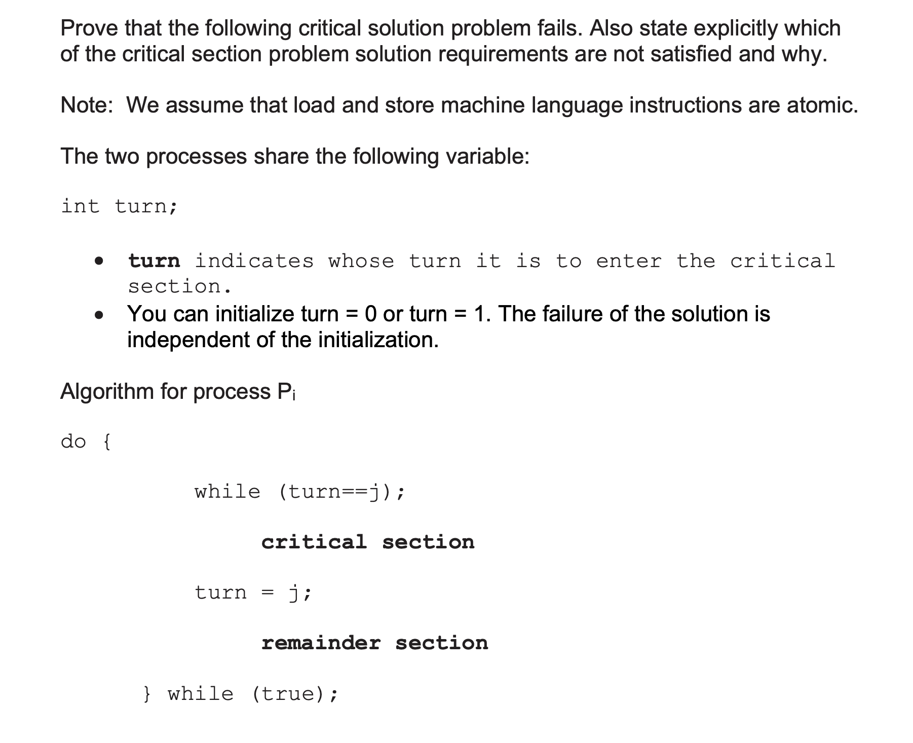
Check Point 2

Slide 52
Check Point 2 Solution
Proof: Here, we assume that (turn is initialized to 0):
The algorithm satisfies the mutual exclusion condition. Suppose both processes try to enter their CS. At any given time, the value of turn = 0 or 1. Therefore, only one process can enter its CS while the other waits (keeps checking its while loop condition). Hence mutual exclusion is satisfied.
The algorithm, however, does not satisfy the progress condition. Suppose process P0 and P1 both wish to enter their CS, only one can. Suppose P0 enters its CS and P1 is waiting. After P0 executes its CS, it sets turn = 1 and executes its remainder section. P1 can now enter its CS code. After executing in its CS, it sets turn = 0. Suppose the remainder section of P0 is huge and P1 is just a few lines. Then it could be the case that P0 is still executing in its remainder section and P1 is waiting to execute in its CS. As a result, the process P0 executing in its remainder section is decided where P1 can execute in its CS. Therefore, condition 2 of progress is not satisfied.

Slide 53
Check Point 3
Consider the code example for allocating and releasing processes shown in next slide.
  Identify the race condition(s).
  Assume you have a mutex lock named mutex with the operations acquire() and release(). Indicate where the locking needs to be placed to prevent the race condition(s).

Slide 54
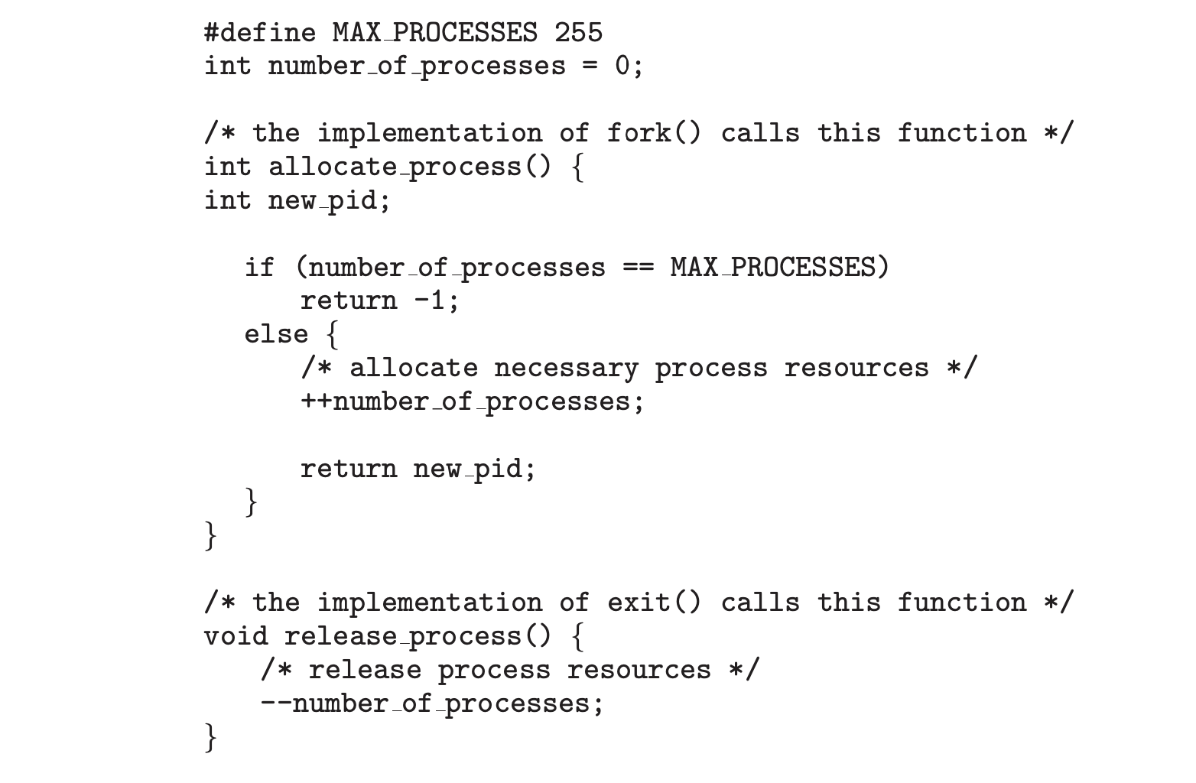
Check Point 3 Cont.

Slide 55
Check Point 4
Illustrate how you would use semaphores to synchronize processes P1, P2, P3, P4 where P1 is executed before P2, P2 is executed before P3, P3 is executed before P4.

Slide 56
Check Point 4 Solution
Initialize synch1, synch2, synch3 = 0
P1:
S1;
signal(synch1);
P2:
wait(synch1);
S2;
signal(synch2);
P3:
wait(synch2);
S3;
signal(synch3);
P4:
wait(synch3);
S4;

Slide 57
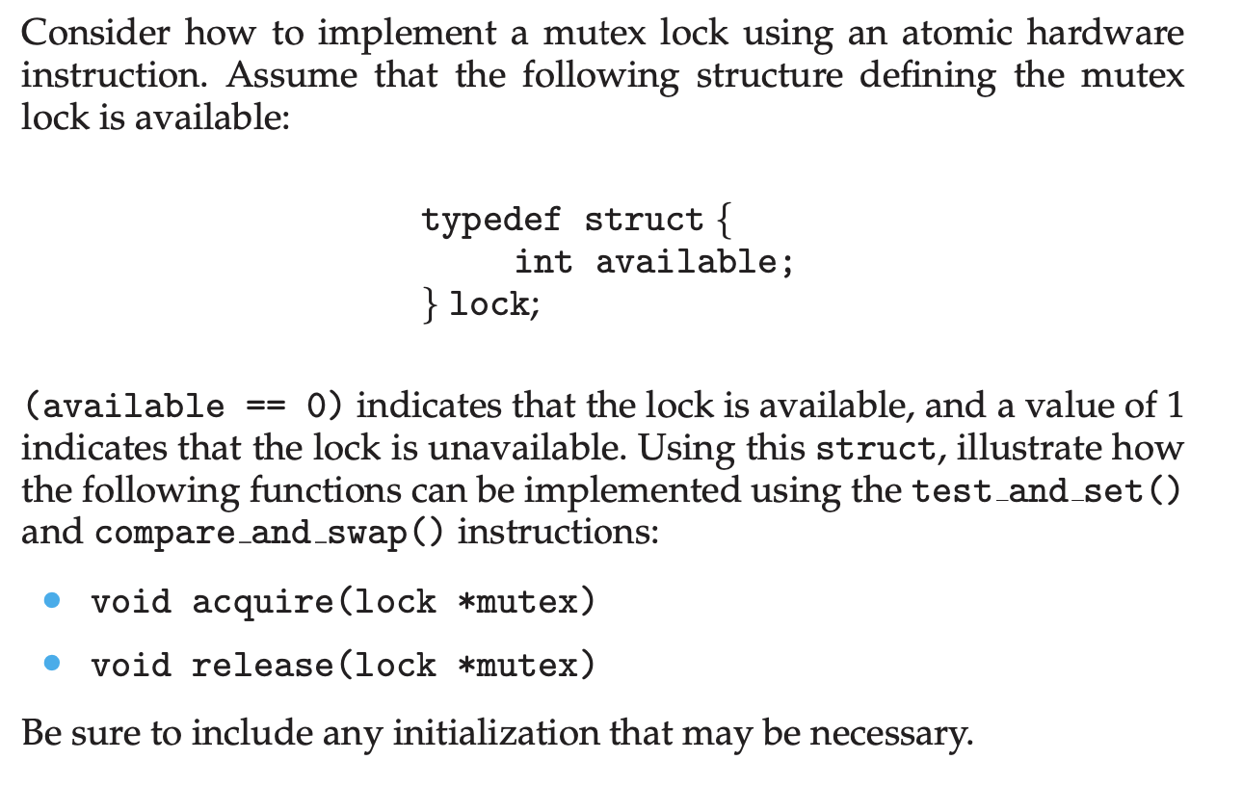
Check Point 5

Slide 58
End of Chapter 6 and 7

